Slide 1


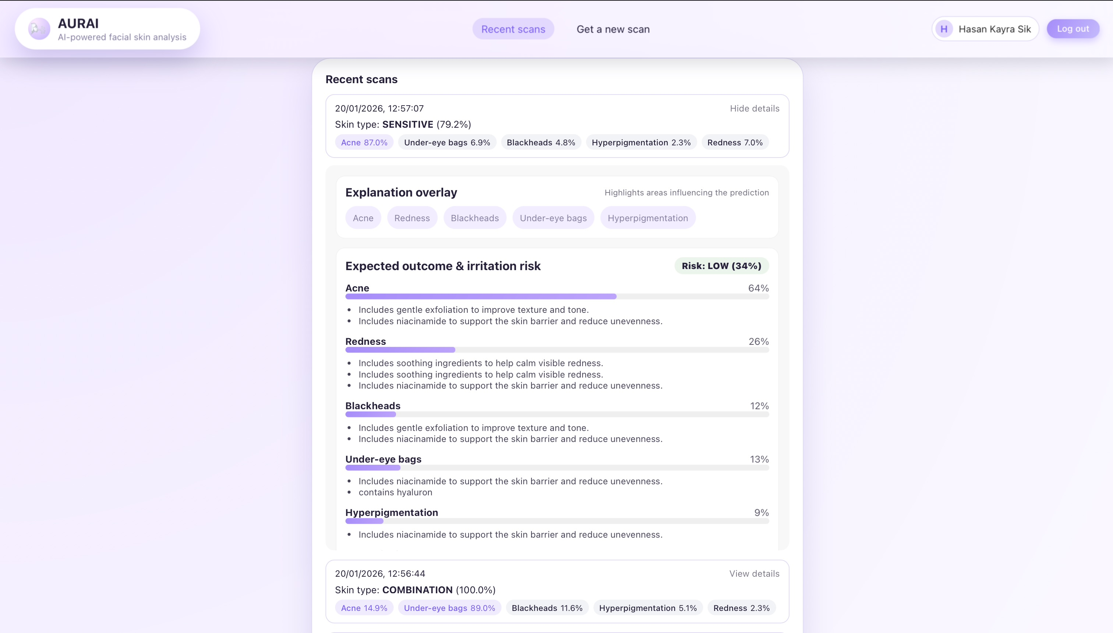
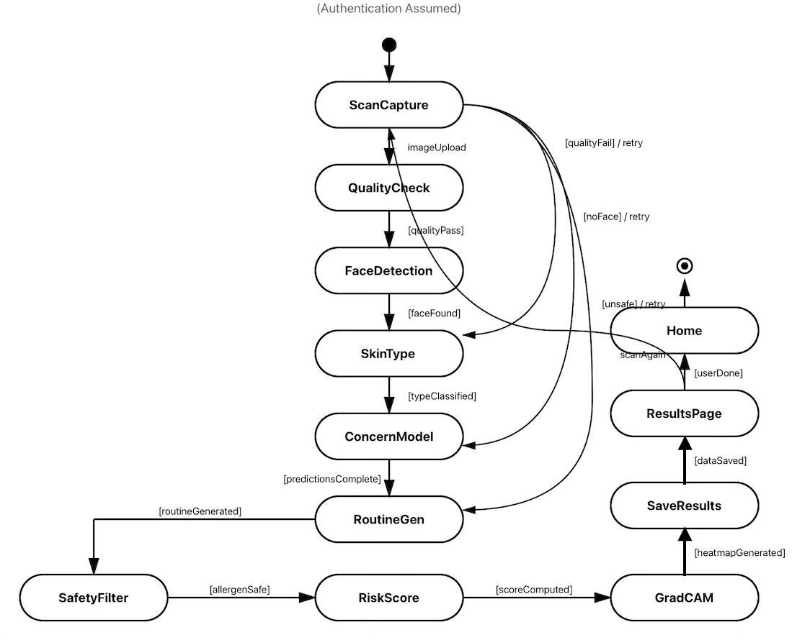
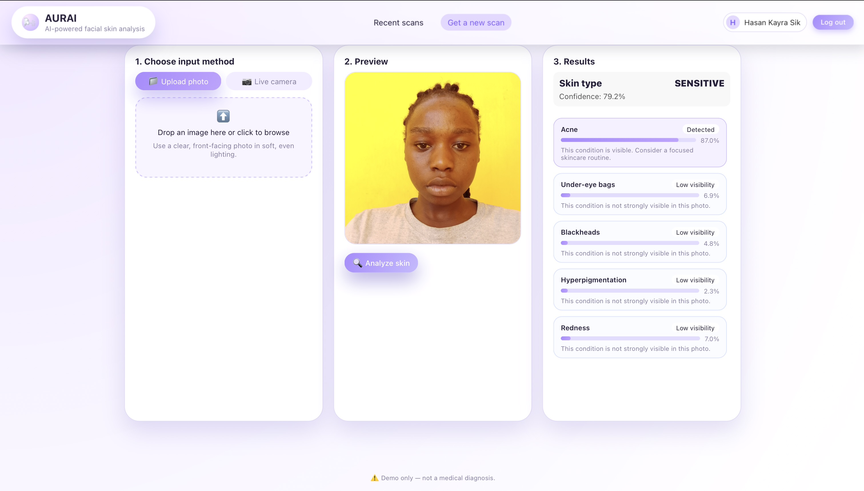
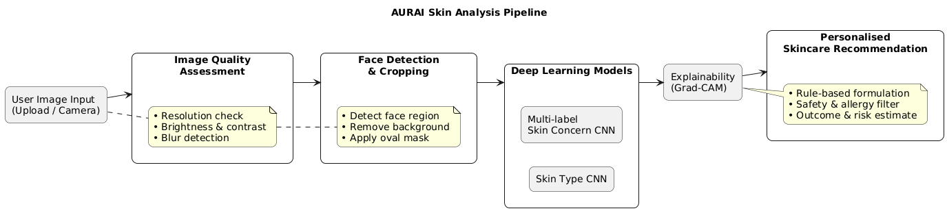
Research:
UFCFXK-30-3: Digital Systems Project
Student name: Hasan Kayra Sik
Project Title: Intelligent Dermatological Care: Artificial Intelligence-Driven Assessment and Prediction for Tailored Natural Formulations
Abstract:
Current dermatological AI fails to capture real-world complexity because it relies on single-label classification, effectively ignoring that conditions like acne and redness often occur simultaneously. Our system employs a multi-label Convolutional neural network (CNN) to detect co-occurring skin conditions from facial images. The system utilises these predictions together with explainability tools to give customised non-diagnostic skincare advice.
Design, Implementation & Testing
State Diagram
Aims and objectives:
To develop and evaluate a multi-label deep learning system to analyse skin images, supporting non-diagnostic consumer-oriented skincare recommendations, while considering explainability, bias and ethical deployment decisions.
The project objectives are:
Develop a CNN capable of multi-label skin condition classification
Assess multi-label learning to model correlated skin attributes in comparison with single label-based approaches.
Apply explainability methods to help users’ understanding.
Incorporate model outputs into a non-diagnostic, personalised skincare recommendation system.
Evaluate dataset bias, fairness and generalizability.
CNNs can achieve dermatologist-level performance in controlled binary skin lesion classification tasks. (Esteva et al., 2017; Brinker et al., 2019)
Dermatological images frequently contain multiple simultaneous skin features, making single-label models unsuitable
Multi-label learning enables the modelling of non-exclusive conditions such as acne, redness, and hyperpigmentation.(Tsoumakas & Katakis, 2007; Zhang & Zhou, 2014)
Dataset bias and limited interpretability highlight the need for assistive rather than autonomous AI systems.
Implementation artefacts
AURAI is implemented as a React frontend and FastAPI backend.
Deep learning models (e.g. CNNs) are used for skin type and multi-label condition analysis.
Explainability and personalised recommendation modules are integrated into the inference pipeline.
Planning and Management:
The project follows an iterative development approach, with cycles of implementation and evaluation.
Completed stages include literature review, dataset preparation, and initial model development
Ongoing work includes model evaluation, refinement, and fairness analysis.
Important risks like dataset bias, overfitting, and ethical issues have been found and are being dealt with.
Progress is tracked against a planned timeline to ensure delivery within project constraints.
Key requirements:
Functional
Accept a skin image as input.
Allow multi-label classification to identify co-occurring conditions.
Provide visuals for explanation of the predictions.
Generate non-diagnostic skin analysis
Store and exhibit results for better interpretations.
Non-functional
This system will not diagnose and it is free from any medical claims or decisions.
The system will take the fairness and bias constraints into account based on dataset composition.
The UI should be intuitive and accessible to non-expert users
The system shall prioritise transparency and ethical deployment in consumer-facing contexts.
References:
Esteva, A., Kuprel, B., Novoa, R.A., Ko, J., Swetter, S.M., Blau, H.M. and Thrun, S. (2017)
Dermatologist-level classification of skin cancer with deep neural networks. Nature, 542(7639), pp.115–118.
https://doi.org/10.1038/nature21056
Brinker, T.J., Hekler, A., Enk, A.H., Klode, J., Hauschild, A., Berking, C., Schilling, B., Haferkamp, S., Schadendorf, D. and von Kalle, C. (2019)
Deep learning outperformed 136 dermatologists in melanoma image classification. European Journal of Cancer, 113, pp.47–54.
https://doi.org/10.1016/j.ejca.2019.04.001
Tsoumakas, G. and Katakis, I. (2007)
Multi-label classification: An overview. International Journal of Data Warehousing and Mining, 3(3), pp.1–13.
https://doi.org/10.4018/jdwm.2007070101
Zhang, M.-L. and Zhou, Z.-H. (2014)
A review on multi-label learning algorithms. IEEE Transactions on Knowledge and Data Engineering, 26(8), pp.1819–1837.
https://doi.org/10.1109/TKDE.2013.39
Testing
Multi-label metrics and per-label accuracy was utilised to evaluate the model’s performance.
Results analysed to identify performance variation across predicted skin categories
Label-level prediction behaviours assessed using confusion matrices.
Two classification models were evaluated; skin type and conditions.
Formal fairness testing across skin types was not conducted and is identified as a limitation

